Slide 1
Metrics obtained with diffusion MRI
A brief explanation

Slide 2
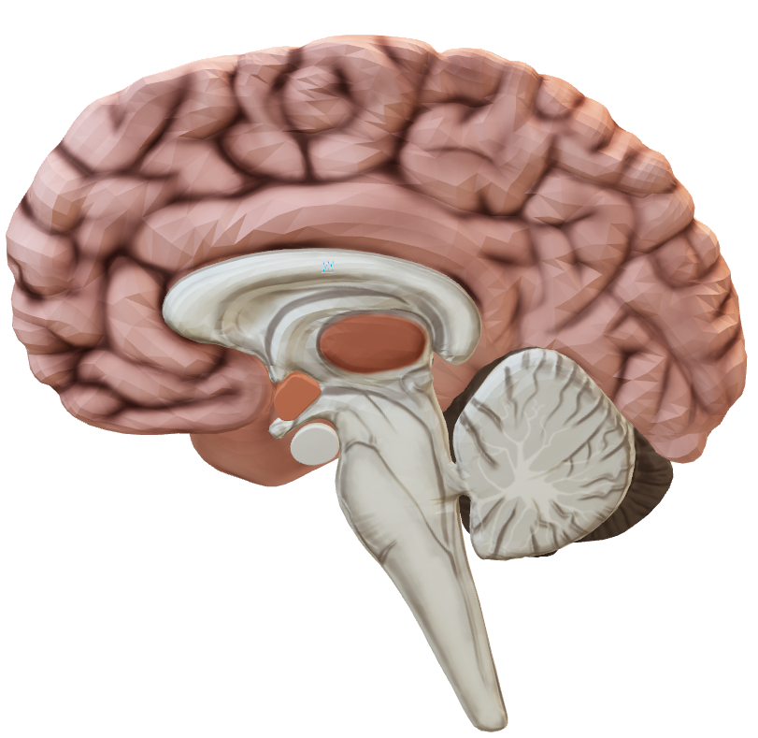
From microstructure to tensors

Slide 3
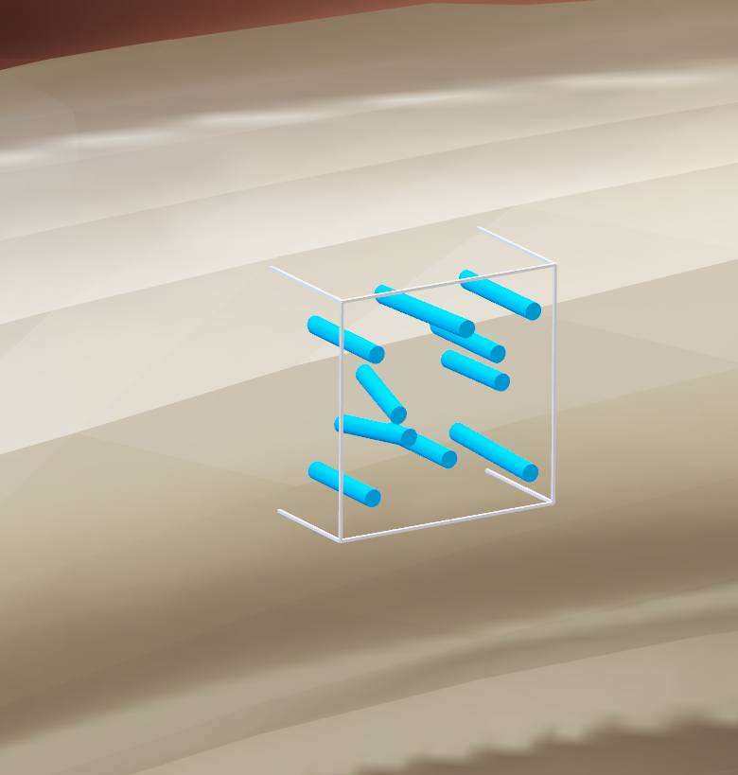
From microstructure to tensors
Voxel : 3D equivalent of a pixel
The objective of the different models is to give information about the structure present in a voxel
1-2 [mm]
1-2 [mm]
Notes:
Pixel voxel

Slide 4
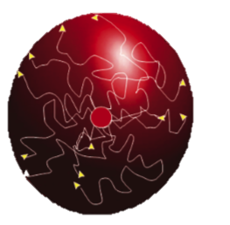
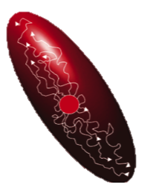
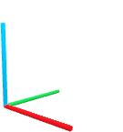
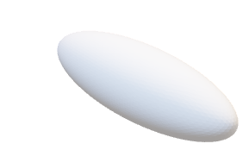
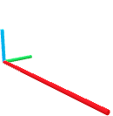
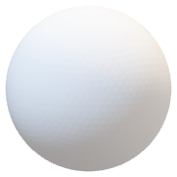
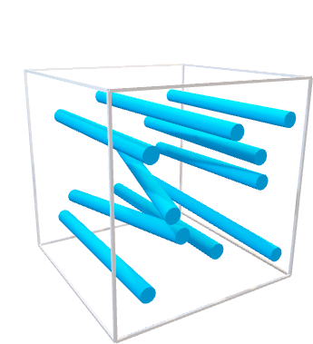
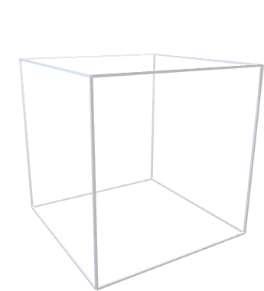
Diffusion tensor imaging (DTI)
Isotropic diffusion
Anisotropic diffusion

Slide 5
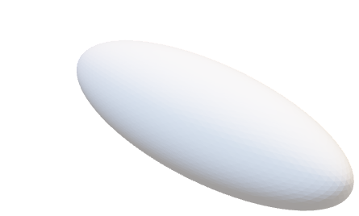


From microstructure to tensors

Slide 6
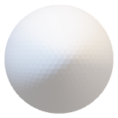

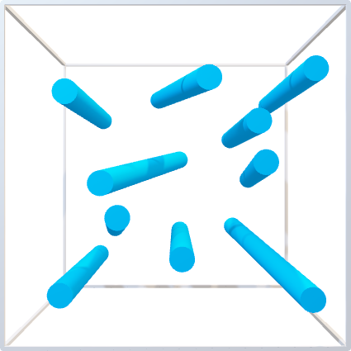
From microstructure to tensors

Slide 7
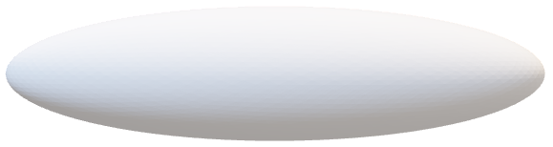


From microstructure to tensors

Slide 8
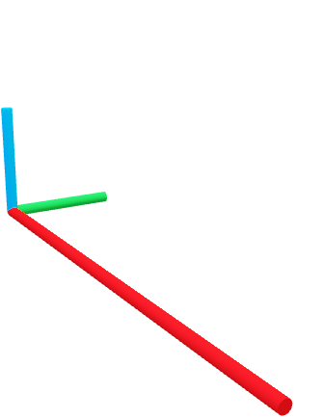
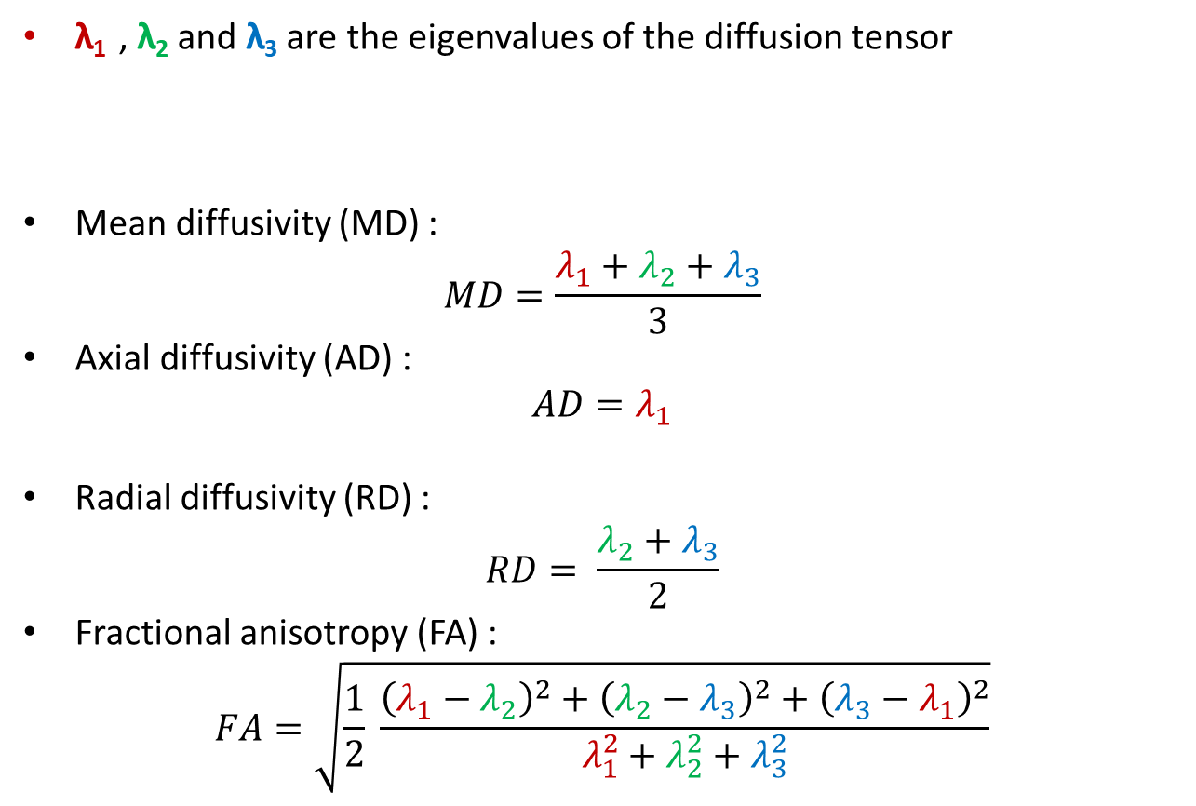
From microstructure to DTI tensors
λ₁ , λ₂ and λ₃ are the eigenvalues of the diffusion tensor
Mean diffusivity (MD) :
$$MD=\frac{λ_{1}+λ_{2}+λ_{3}}{3}$$
Axial diffusivity (AD) :
$$AD=λ_{1}$$
Radial diffusivity (RD) :
$$RD= \frac{λ_{2}+λ_{3}}{2}$$
Fractional anisotropy (FA) :
$$FA=\sqrt{\frac{1}{2} \frac{{\left(λ_{1}−λ_{2}\right)}^{2}+{\left(λ_{2}−λ_{3}\right)}^{2}+{\left(λ_{3}−λ_{1}\right)}^{2}}{λ_{1}^{2}+λ_{2}^{2}+λ_{3}^{2}}}$$
λ₃
λ₂
λ₁

Slide 9
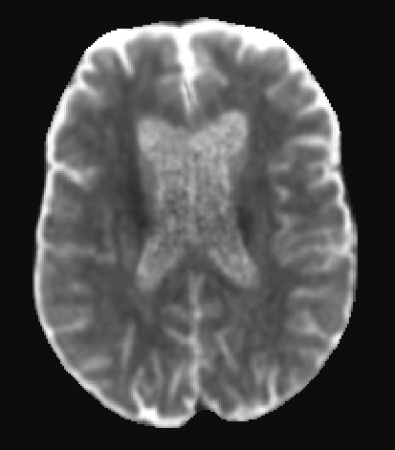
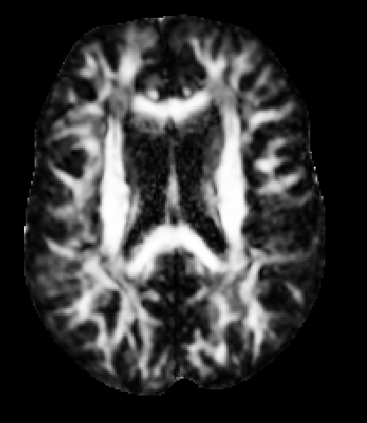
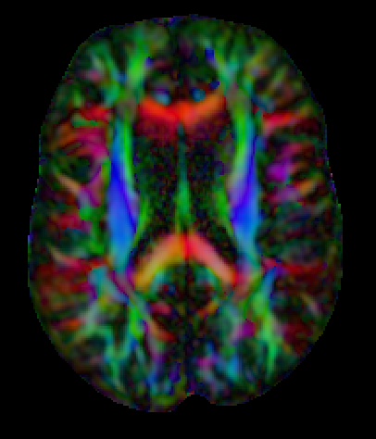
Diffusion tensor imaging (DTI)
The diffusion is represented by 1 diffusion tensor per voxel
Outputs : FA a scalar value between [0,1]
MD, AD & RD a value between 0 to 3.10⁻³ [mm²/s]
Mean diffusivity (MD)
Fractional anisotropy (FA)
Main direction (RGB)
Notes:
FA (Fig.3.13 (left)) is widely considered to be an indirect measure of axonal integrity, even if some find it more accurate to consider FA as an indication of the density of packing of fibers in a voxel, and the amount of myelin wrapping these axons [57]. The value of FA ranges from 0 (completely isotropic diffusion) to 1 (completely anisotropic diffusion). The MD (Fig.3.13 (middle)) represents the diffusion of the water molecules in the brain’ structures and is a weighted average of the axial (AD) and radial diffusivity (RD). MD is considered to be an indicator of white matter damage and ranges roughly from 0 to 3.10−3 [mm2/s], which corresponds to the diffusivity in the CSF.
FA is often considered to be a measure of axonal integrity. However, FA should be interpreted carefully due to the different tissue properties that it encompasses. It may be an indication of the density of packing of fibers in a voxel, and the amount of myelin wrapping these axons
AD values may reflect axonal swelling, degeneration or deletion. RD represents the water diffusivity perpendicular to the axonal fibers. Altered RD may reflect myelin disruption

Slide 10
Diffusion tensor imaging (DTI)
Mean diffusivity (MD):
- represents the mean diffusion of the water molecules in the voxel
- is often considered to be an indicator of white matter damage
Axial diffusivity (AD):
- may reflect axonal degeneration or deletion
Radial diffusivity (RD):
- represents the water diffusivity perpendicular to the axonal fibers
- may reflect myelin disruption
Fractional anisotropy (FA):
- is widely considered to be an indirect measure of axonal integrity
- might be more accurate to consider FA as an indicator of the density of packing of fibers in a voxel

Slide 11

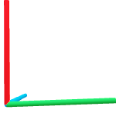
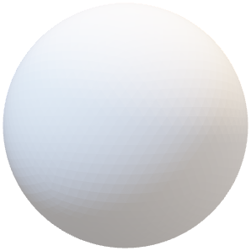
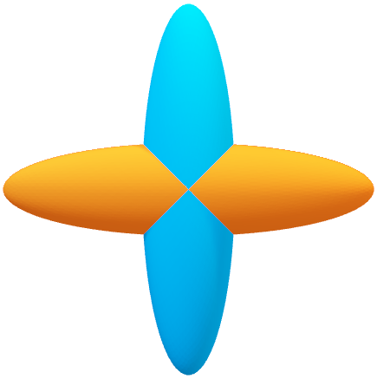
Single compartment models and crossing fibers
Metrics obtained with DTI are heavily impacted by crossing fibers:
→ A voxel with visually high anisotropy can present an FA close to 0

Slide 12
Multi-compartment models

Slide 13
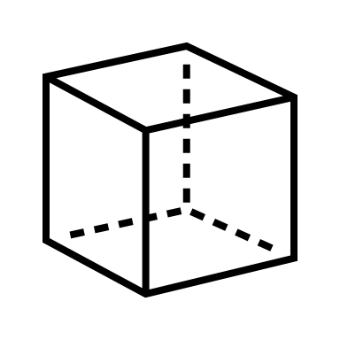
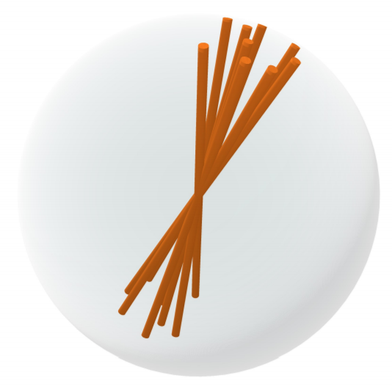

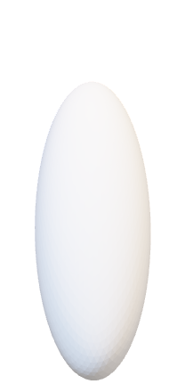
NODDI
Fluid compartment | Extracellular compartment | Intracellular compartment
Isotropic diffusion | Anisotropic diffusion | Watson distribution of ‘sticks’

Slide 14
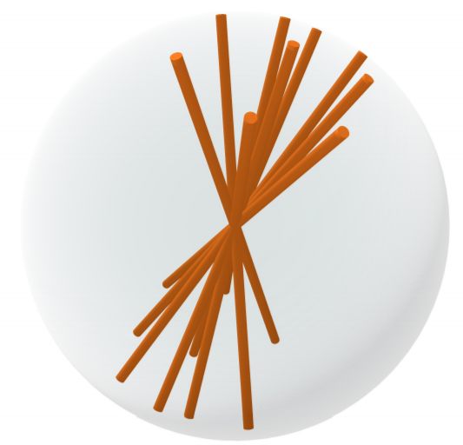

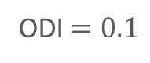
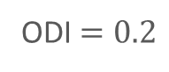
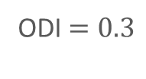
NODDI
Metrics : intracellular volume fraction (ficvf = Neurite Density Index NDI) and isotropic fraction (fiso)
The ‘sticks’ have a varying ‘heterogeneity’ in their distribution :
→ Orientation dispersion index (ODI), a value between [0,1]
ODI $=0.3$
ODI $=0.2$
ODI $=0.1$

Slide 15
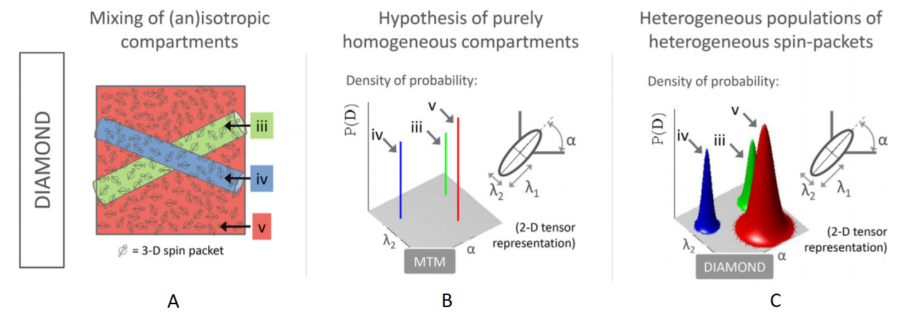

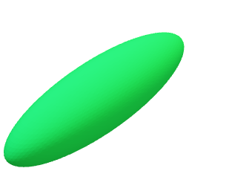
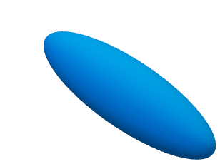
DIAMOND
Multi-compartment model :
Fiber populations : heterogenous distribution of anisotropic Gaussian diffusions
Isotropic compartment : isotropic Gaussian diffusion

Slide 16
DIAMOND
Multi-compartment model :
Fiber populations : heterogenous distribution of anisotropic Gaussian diffusions
Isotropic compartment : isotropic Gaussian diffusion
[1]

Slide 17
DIAMOND outputs per compartment
Volume fraction (fraction)
Heterogeneity index (HEI) :
→ Similar to ODI metric in NODDI
Volume fraction (fraction)
Heterogeneity index (HEI)
Volume fraction (fraction)
Between [0,1]

Slide 18
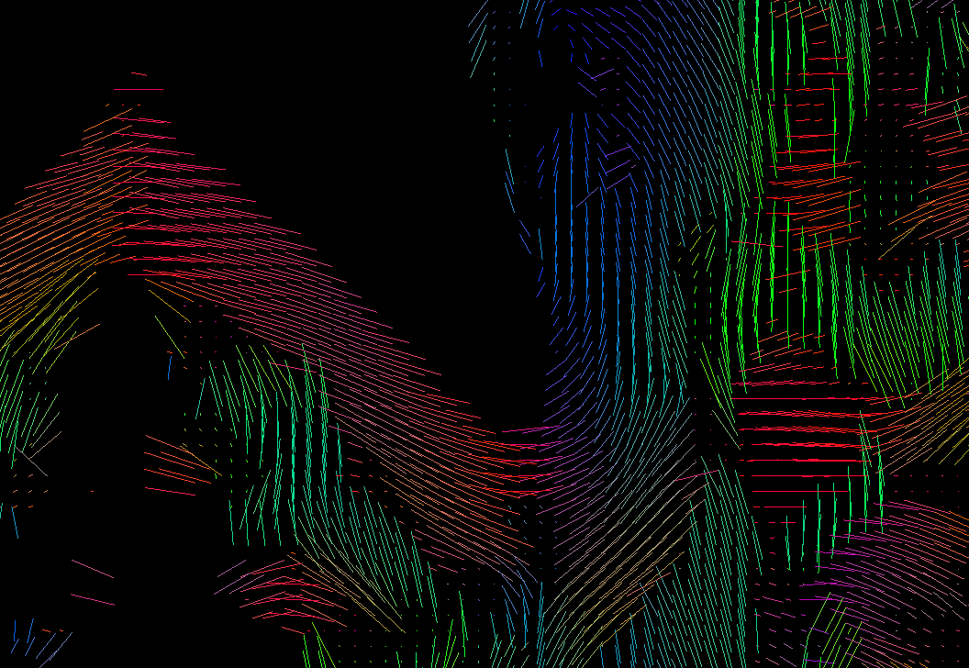
DTI metrics from DIAMOND tensors

Slide 19
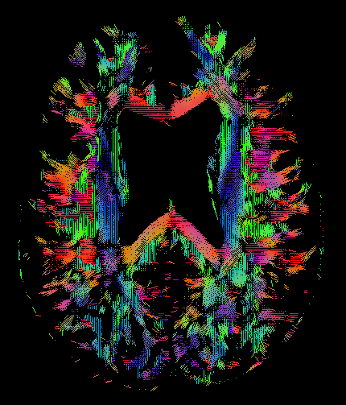
DTI metrics from DIAMOND tensors
For each DIAMOND tensor:
t1_FA
t0_FA
Weighted average
wFA
t0_MD
t0_AD
t0_RD
Tensor 0 (t0) Representing the main fiber population

Slide 20
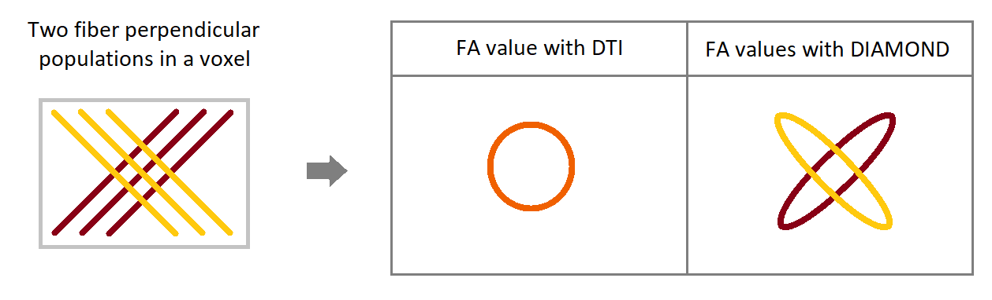
DTI metrics from DIAMOND tensors

Slide 21
Microstructure fingerprinting
The expected response signal are pre-computed beforehand :
Cylinders, representing the axons, with varying orientation, density and packing are listed in a dictionary

Slide 22
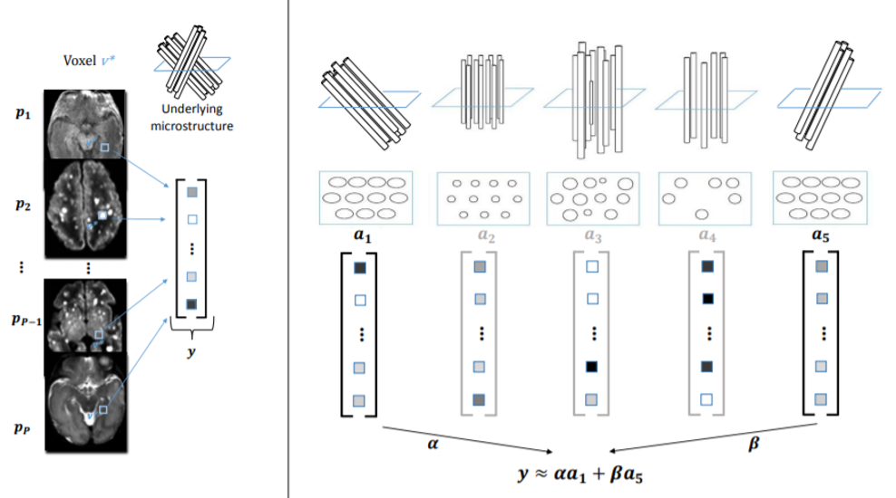
Microstructure fingerprinting
Dictionary
generated with Monte Carlo simulations
Dictionary
matching
[2]

Slide 23
Microstructure fingerprinting
Free diffusivity
Fiber population 1
Fraction of the CSF compartment (frac_csf)
Fraction of the first fiber population (frac_f0)
Fraction of the second fiber population (frac_f1)
Fiber volume fraction of the first fiber population (fvf_f0)
Fiber volume fraction of the second fiber population (fvf_f1)
Total fiber volume fraction (fvf_tot)
Extra-axonal diffusivity of the first fiber population (DIFF_ex_f0)
Extra-axonal diffusivity of the second fiber population (DIFF_ex_f1)
Fiber population 0

Slide 24
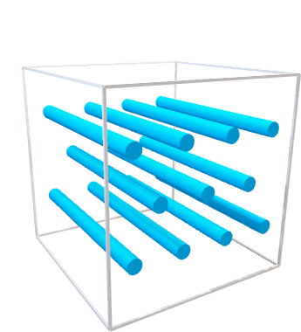
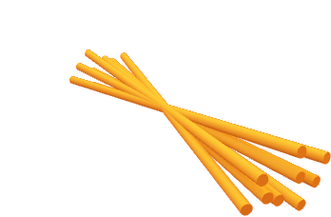
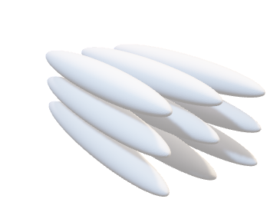
Simplified visualization of each model
DTI | NODDI | DIAMOND | Microstructure Fingerprinting

Slide 25
Any questions ?

Slide 26
References
[1] B. Scherrer, A. Schwartzman, M. Taquet, M. Sahin, S. Prabhu, and S.K. Warfield. Characterizing brain tissue by assessment of the distribution of anisotropic microstructual environments in diffusion-compartment imaging (diamond). Magnetic Resonance in Imaging, 76(3):963–77, 2015. http://onlinelibrary.wiley.com/doi/10.1002/mrm.25912/abstract.
[2] Gaëtan Rensonnet. Generation of a dictionary of dw-mri signals from arbitrary brain microstructure configurations (master thesis). Universite catholique de Louvain, 2015.

Slide 27
Annex

Slide 28
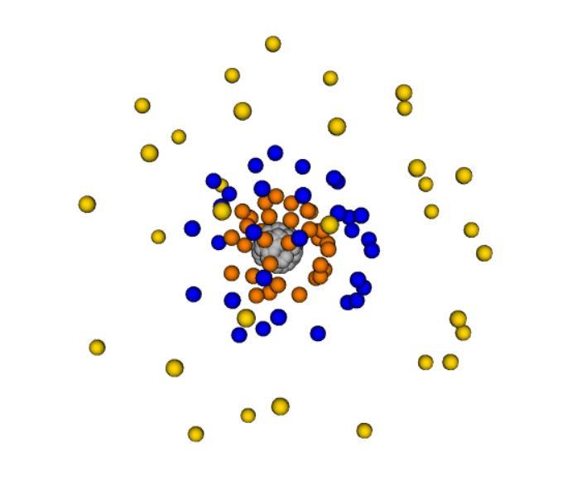
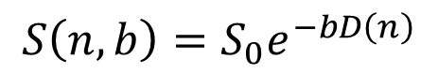
DTI formula and multi-shell illustration
b-value base signal
direction diffusivity
$$S\left(n,b\right)=S_{0}e^{−bD\left(n\right)}$$

Slide 29

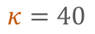
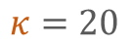
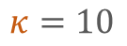
NODDI
Metrics : intracellular volume fraction (ficvf = Neurite Density Index NDI) and isotropic fraction (fiso)
The ‘sticks’ have a varying ‘homogeneity’ κ in their distribution :
$$κ=10$$
$$κ=20$$
$$κ=40$$
→ Orientation dispersion index (ODI) :
$$ODI=\frac{2}{π}\arctan{(1/{κ)}}$$

Slide 30
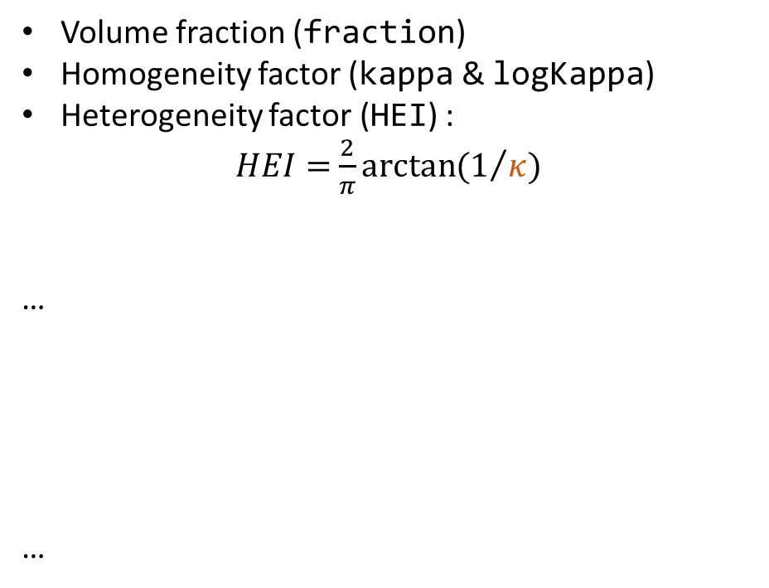
DIAMOND outputs per compartment
Volume fraction (fraction)
Homogeneity factor (kappa & logKappa)
Heterogeneity factor (HEI) :
$HEI=$ $\frac{2}{π}\arctan{(1/{κ)}}$
…
…

